Slide 1
Unit 4
Open Source and Network Administration

Slide 2
Why Open Source?
It refers to software whose source code is available to the public without restriction. It also means the software can be modified by anyone for any use and that the modified program can also be redistributed as open source.

Slide 3
Open Source Tools
SNMP. The Simple Network Management Protocol is the standard for remote administration of network devices includes a well-known set of tools for accessing information via SNMP.
MRTG. The Multi Router Traffic Grapher is a very widely used tool for graphing bandwidth and other network statistics.
Neo. This tool was written at MIT for high-level administration of switches, routers, and other devices that speak SNMP.
NetFlow. NetFlow is a Cisco mechanism for collecting information about the internals of IP network traffic describes a well-known package called Flow-Tools that collects and processes NetFlow information.
Oak. Oak is a tool written at MIT for collecting syslog messages from servers and network equipment, condensing the information as appropriate, and notifying operators of problem conditions when they arise.
Service Monitoring. The Sysmon program, tests network hardware and server software to ensure they are functioning, and if they are not, it notifies the appropriate administrators.
Tcpdump. This is a standard program for directly analyzing network traffic at the packet level.
Basic Tools.:the ping, telnet, netcat, traceroute, MTR, and netstat programs.

Slide 4
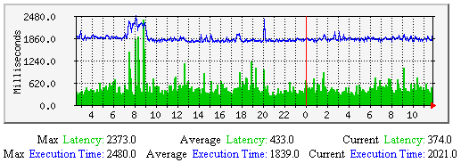
Graphing Performance Info With MRTG

Slide 5
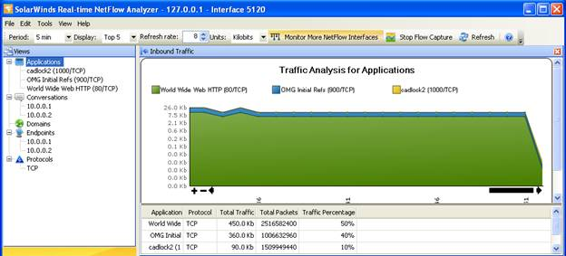
NetFlow Analyzer

Slide 6
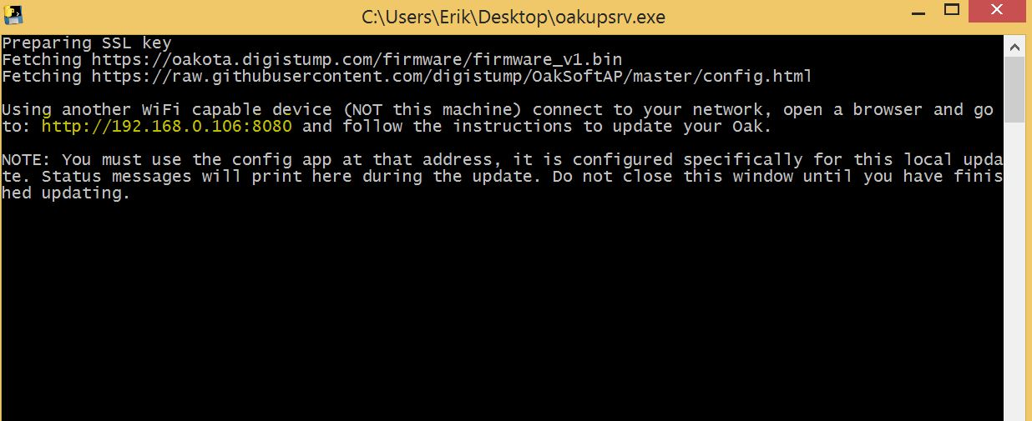
oak network tool

Slide 7
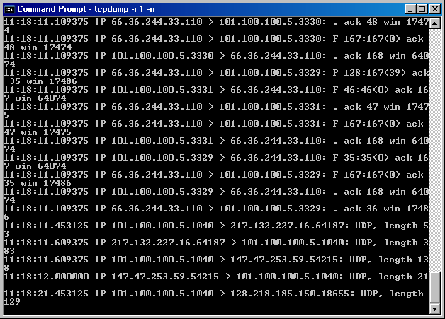
tcpdump

Slide 8
Environment
Unix operating system, in particular Solaris and Linux. All of the programs should work on other flavors of Unix.
A number of the programs advertise that they work under Windows too
The modern versions of MacOS run Unix under the hood, it should be possible to build the tools for those platforms as well.

Slide 9
Background
The basics of networking and the Open System Interconnection (OSI) layered network model.
Terminology and Conventions
The terms workstation, host, device, and node are all used interchangeably in
networking and in this text as well.
The use of one instead of another is not meant to imply anything about the hardware
in question, though the choice of word may reflect an expectation of common use.

Slide 10
Overview of Service Monitoring
The most common type of problem that network administrators deal with is something that spontaneously stops working:
A network link fails, a Web server refuses connections, or a switch stops passing traffic.
Often, failures like these do not result in any kind of notification to administrators
The solution is to use some kind of monitoring or polling software.
This is a program running on one or more servers that sends out probes at regular intervals in order to test network connectivity and service functionality
This software may ping all of your switches and routers. If a device does not respond, the failure is reported to the appropriate administrators.
The software might also attempt to retrieve Web pages, make SNMP requests, or perform other kinds of service level testing. Any failure to respond as expected can similarly be reported to an appropriate administrator.

Slide 11
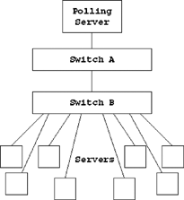
Many Servers Behind a Single Failed Device.
If the software knows that switch B has to be operating in order for the servers behind it to respond, it can ignore the failed tests for the servers and simply report that switch B is not responding.

Slide 12
Note that system polling can have an impact on the performance of the network or the devices being monitored
There are two pieces of free, open source software that make good service monitors.
One is called Sysmon, available from http://www.sysmon.org/. This is a relatively simple program that is easy to configure and get running
The other tool is called Nagios and is available from http://www.nagios.org/. This is a better tool for large networks. It is a much more complicated program, but it includes advanced functionality that may be required at a larger installation

Slide 13
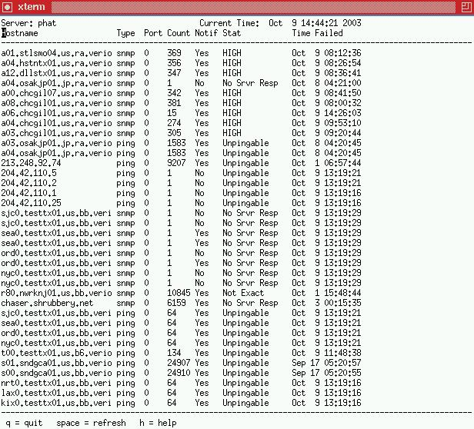
What Service Monitoring Can Help You Do
The most obvious benefit to running a service monitor is that it gives you early warning of failures. Practically speaking, this allows you to fix a problem before it becomes an even larger problem.

Slide 14
How to Install Sysmon
The installation for Sysmon is mostly straightforward.
Download the latest version from http://www.sysmon.org/, then unpackage and
build the software.
There is one step that is out of the ordinary; you must change to the src directory
before typing make:
# gunzip -c sysmon-0.91.17.tar.gz | tar xvf –
# cd sysmon-0.91.17
# ./configure Solaris# cd src
# make
# file sysmon sysmon: ELF 32-bit MSB executable SPARC Version 1, dyn...
# file sysmond sysmond: ELF 32-bit MSB executable SPARC Version 1, dyn...
At this point, you can install the software from a root account. By default, it will place the sysmon and sysmond programs in /usr/local/bin/:
# make install

Slide 15
Using Sysmon
Starting the Sysmon Daemon
While Sysmon does not strictly have to be run from a root account, any account that does not have root privileges will be unable to run ping tests.
Before starting the Sysmon daemon, you will need to create a configuration file.
A short sample config will be sufficient for now.
Place the following in /usr/local/etc/sysmon.conf, which is the default location for the
configuration file:
root="server";
config showupalso;
config statusfile text "/var/tmp/status.txt"; object server { ip "server.example.com"; type ping;
contact "admin@example.com";
};

Slide 16
Stopping the Sysmon Daemon
Though you can kill Sysmon by sending it a signal, it is more convenient to use the
sysmond program instead:
# /usr/local/bin/sysmond stop
sysmond: 15:35:33 sending signal 15 to sysmond process 7467
sysmond: 15:35:33 Please remain seated as your ride comes to a...
As the output indicates, this is equivalent to sending a TERM signal to the sysmond
process
Pausing Sysmon
You can also instruct Sysmon to temporarily stop functioning and then resume later
with the pause and resume commands:
# /usr/local/bin/sysmond pause
sysmond: 15:37:15 sending signal 17 to sysmond process 7486
# /usr/local/bin/sysmond resume
sysmond: 15:37:19 sending signal 17 to sysmond process 7486

Slide 17
Reloading the Configuration
After changes are made to the configuration file, Sysmon has to either be restarted or be instructed to reload the configuration. Otherwise, the changes will not take effect. The reload command is executed as:
# /usr/local/bin/sysmond reload
sysmond: 19:07:23 sending signal 1 to sysmond process 7486
sysmond: 19:07:23 Done reloading new config file
The reload command sends a HUP signal to sysmond. If the configuration is not valid, the process will continue to run with the old configuration. Otherwise, the new configuration will take effect.

Slide 18
Connecting with a Remote Client
Sysmon runs a TCP service on port 1345 where it provides data about monitored services. You can connect to it using the curses client that was built and installed as /usr/local/bin/sysmon:
Solaris% /usr/local/bin/sysmon server.example.com
The screen will clear and a display like the following will come up:
Server: server Current Time: Apr 7 18:22:57 2003 Hostname Type Port Count Notif Stat Time Failed
q = quit space = refresh h = help
Only services that are down or have failed tests will be present. You can exit this application by pressing press the "q" key.

Slide 19
Configuring Sysmon
Once you have verified that sysmond is up and running, you can begin to fill out the configuration with the devices you wish to monitor. The Sysmon configuration is made up of a list of objects to be monitored, along with a section of global configuration options. Within each object definition, you must specify the IP address of the device to be tested, the kind of test that should be performed, and any objects the device depends on. When object A is configured to depend on object B, notifications will not be sent about the status of object A if object B is also unreachable.
The Root Node
Sysmon requires one object to be defined as the root of the device hierarchy. This is the object that all others depend upon to be up. A good choice for this is the server that Sysmon runs on itself.
root="server";

Slide 20
Objects and Dependencies
Now you can add to the configuration other objects to be monitored. Start by adding a simple ping test for the router that server.example.com is connected to:
object router1
{
ip "192.0.2.5";
type ping;
desc "Router1";
dep "server";
contact "admin@example.com";
};

Slide 21
Maintaining Sysmon
The toughest part of maintaining Sysmon is keeping your configuration in check with reality, especially if you have a large installation or if the people who are deploying equipment are not the same ones who will be updating the config. However, if you wish to have your notification system consistently alert you to trouble, you must keep the configuration accurate. This requires some discipline. Because failures do not occur often, it is easy to forget about the importance of updating the files. If the data becomes stale, with many devices marked as failed that really have been taken out of service, it will become hard to trust Sysmon when it reports that a device has failed. It becomes the server that "cried wolf."

